Slide 1
E-HealthCare System
Pritesh Chauhan

Slide 2
User Roles and Functionality
Administrator: Able to update and delete the patient, doctor and pharmacist
Patient:
Re-Visiting Patient: Can select the doctor that he/ she has visited or make a new doctor selection
New Patient: Can make the selection from the list of available doctors
Doctor: Attend the visiting patient and prescribe the medicines and get history data
Pharmacist: Can place the orders of the medicine and add them if out of stock

Slide 3
Features Used
Exporting Data Using CSVJDBC driver
Sending Emails
Error Handling
JSTL library
MVC Design Pattern
CRUD Operations
URL Mapping
XML Mapping
Annotation @WebServlet
Database Query
JDBC Statement
JDBC PreparedStatement
Session Management

Slide 4
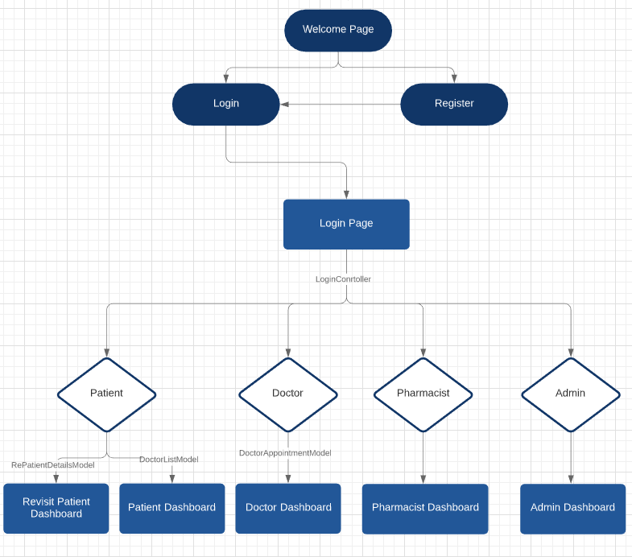
Login
Concepts covered
MVC Design Pattern
JDBC Statement
Session Management
Error Handling

Slide 5
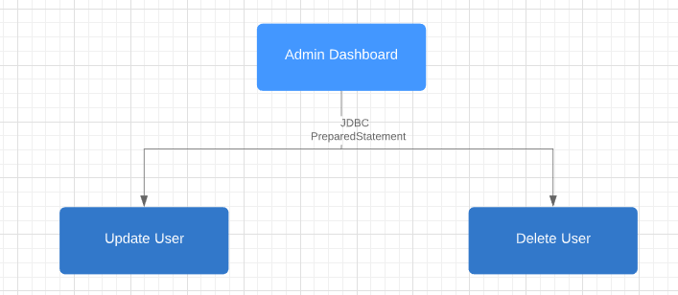
Admin
Concepts covered
Servlet XML Mapping
JDBC PreparedStatement
Session Management
Error Handling

Slide 6
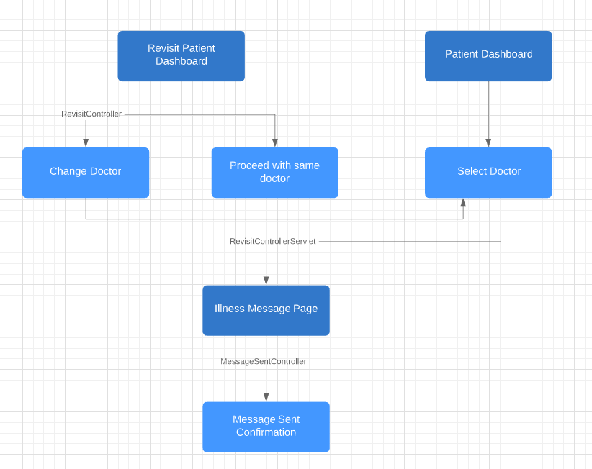
Patient
Concepts covered
Annotations using Web Servlet
Session Management
Error Handling
JDBC Statement

Slide 7
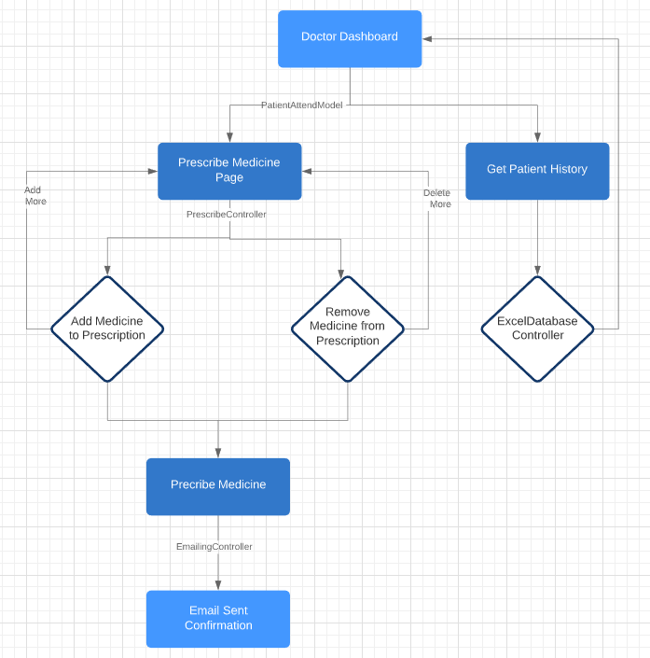
Doctor
Concepts covered
Annotations using Web Servlet
Session Management
Error Handling
Exporting Data Using CSVJDBC driver
Sending Emails
JDBC

Slide 8
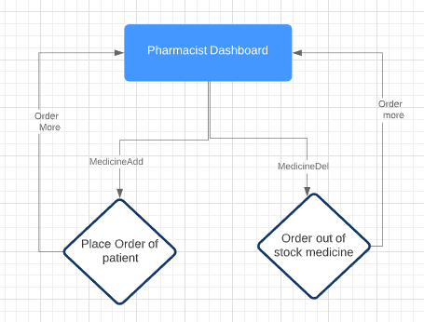
Pharmacist
Concepts covered
JDBC PreparedStatement
Session Management
Error Handling
JDBC Statement

Slide 9

Thank You

